Slide 1
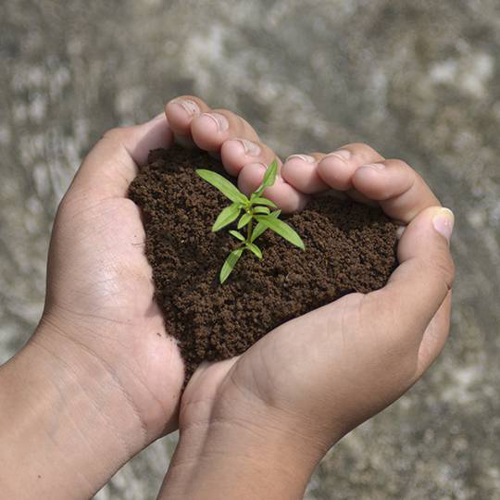
MODULE 9:
Managing Soil Carbon

Slide 2

Objectives
Discuss the importance and management of soil carbon.
Determine which soil carbon amendments are most appropriate for specific agricultural scenarios.

Slide 3
Question
What is soil carbon?
How does carbon relate to soil organic matter ?
Notes:
Ask the group for discussion. Take a handful of responses

Slide 4
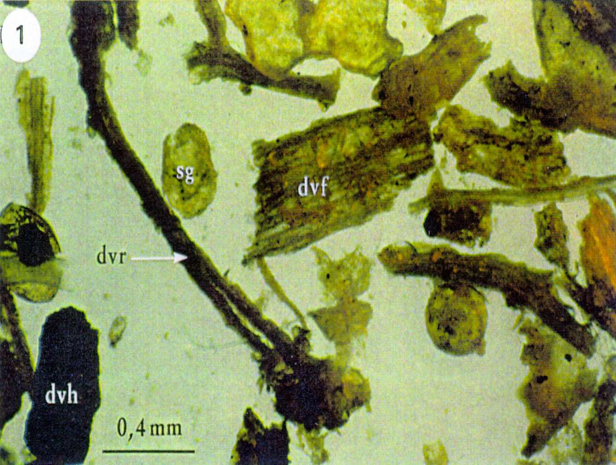
What is Soil Carbon ?
The carbon contained in soil organic matter.
Soil organic matter includes:
  Dead and decaying plant and animal residues
  Amorphous carbon based compounds (microbial and plant byproducts)
  Living biomass
Soil organic matter is approximately 50% carbon

Slide 5
Soil Carbon
Why is soil carbon important?
What does it contribute to soil health and ecosystems?

Slide 6
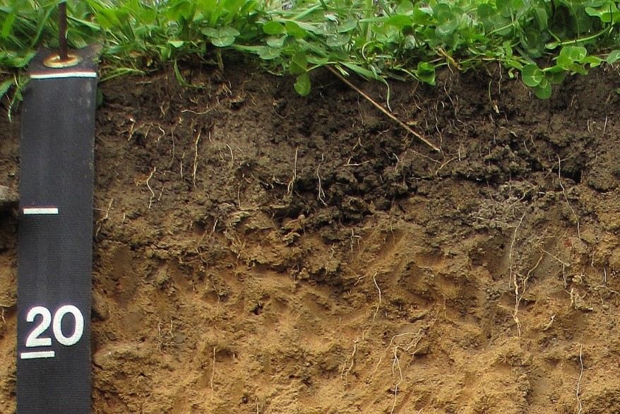
Importance of Soil Carbon
Provides food for soil organisms.
Enhances soil microbial biodiversity and activity which can help in the suppression of diseases and pests.
Improves cation exchange capacity.
Supports soil aggregation and structure, which
  Enhances water infiltration and storage
  Reduces erosion

Slide 7
Question
How do we increase the amount of carbon in a soil through management ?

Slide 8
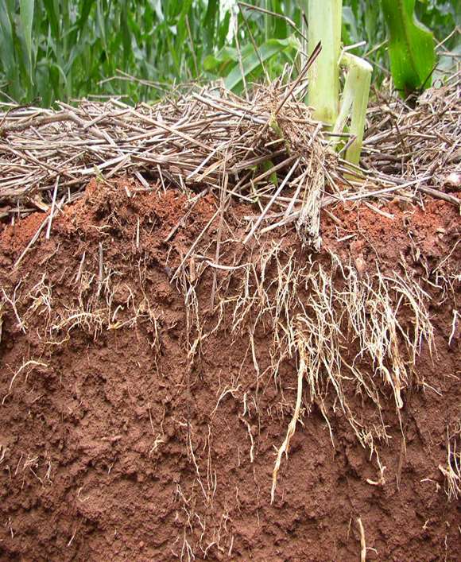
Managing Soils to Increase Carbon
Increase Inputs of Carbon (Feed)
  Apply carbon-based amendments (e.g., manure, compost, biochar)
  Cover crops
  High crop productivity
Reduce Decomposition (Protect)
  Reduced tillage.
  Precise nutrient inputs.

Slide 9
How is carbon stored in the soil?
In living biomass (Microbes, etc.).
Organic materials are surrounded by soil aggregates.
Organic molecules bind to the surface of soil clays (Organo-mineral associations).
Some organic materials occur in forms that are resistant to decomposition (Biochar).
Notes:
Storage of carbon in soils is ultimately a property of the system. A farming system needs support an ecosystem that keeps carbon in soils.
Framework is originally from Sollins et al. 1996 publication.
https://www.researchgate.net/publication/223570199_Stabilization_and_Destabilization_of_Soil_Organic_Matter_Mechanisms_and_Controls

Slide 10
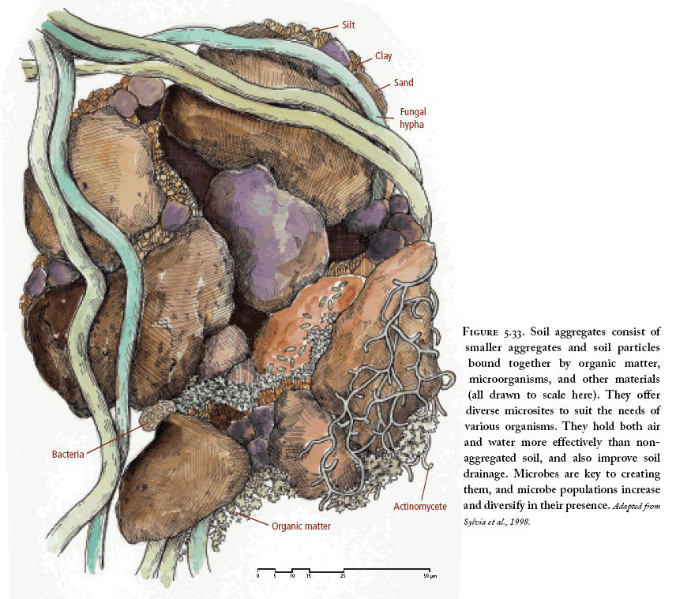
Soil Structure and Carbon Storage
3. Bound to clay minerals
2. Inside soil aggregates
1. Living Biomass
Drawing from Jacke and Toensmeier (2005)
Notes:
Drawing from Jacke and Toensmeier (2005)

Slide 11
CPS 336 Soil Carbon Amendment
What Is it ?
Application of carbon-based amendments derived from plant materials or treated animal byproducts.
Amendments include:
  Compost
  Biochar
  Compost + Biochar Mixes
  Other carbon-based amendments

Slide 12
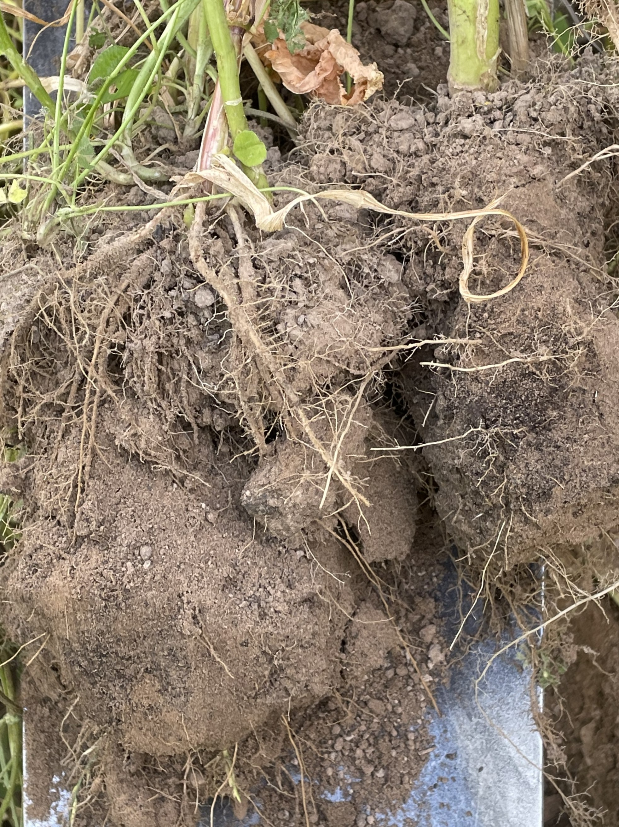
Soil Carbon Amendment–
Physical Effect on SH Resource Concerns
“Carbon based amendments are added to the soil”
Soil organism habitat: improving soil habitat for organisms.
Aggregate instability: improving soil structure.
Organic matter depletion: improving organic matter depletion.
“Amount and placement are controlling factors along with tillage and crop rotation.”
Notes:
These three bullet points of improving soil organism habitat, improving aggregate instability and improving organic matter depletion are the primary purposes of this practice – along with sequestering C and enhancing soil C stocks.
Bottom point is in bold because those variables all affect the ability of soil carbon amendments to improve soil health.

Slide 13
Soil Carbon Amendments and their use in Small-scale agriculture

Slide 14
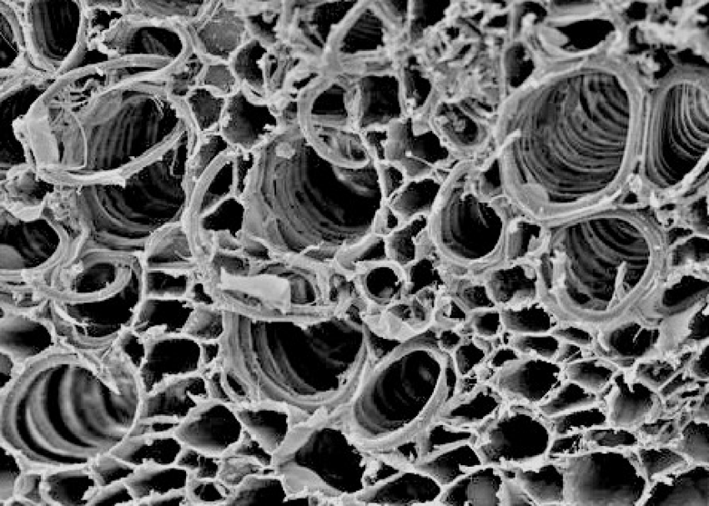
What is Biochar?
Carbon that is pyrolyzed at high temperatures (usually between 500 – 1300° F) and low oxygen.
Creates a very stable form of carbon.
Acts like a sponge in the soil holding water, air, and nutrients.
Large surface area creates habitat for soil microbiology that can cycle nutrients.
Diverse end products, depending on feed stock and process

Slide 15
Where is Biochar is Most Commonly Used?
Yes
Sandy or droughty soils
Low pH soils
High tunnels
Permanent beds
Perennial plantings
Biochar/Compost Mix
Caution!
High pH soils (over 7.0)
Flood plains or slopes when it is surface applied
100% biochar that is not “charged” with nutrients
C Amendment with a high C:N ratio.

Slide 16
Considerations for selecting A Biochar
High organic carbon content (above 85%) is ideal.
Low ash.
Low H:C ratio. The lower the more stable the carbon. H:C ratio must be under 0.7 to meet NRCS standards.
Low liming equivalency (unless soils are acidic).
High salts and nutrients in manure based biochars.

Slide 17
Potential Benefits of Biochar for Urban and Small Farms
Improves water holding capacity of soils
Reduces/eliminates odors.
Can reduce the need for fertilizer.
Can tie up heavy metals.
Can immobilize salts.

Slide 18
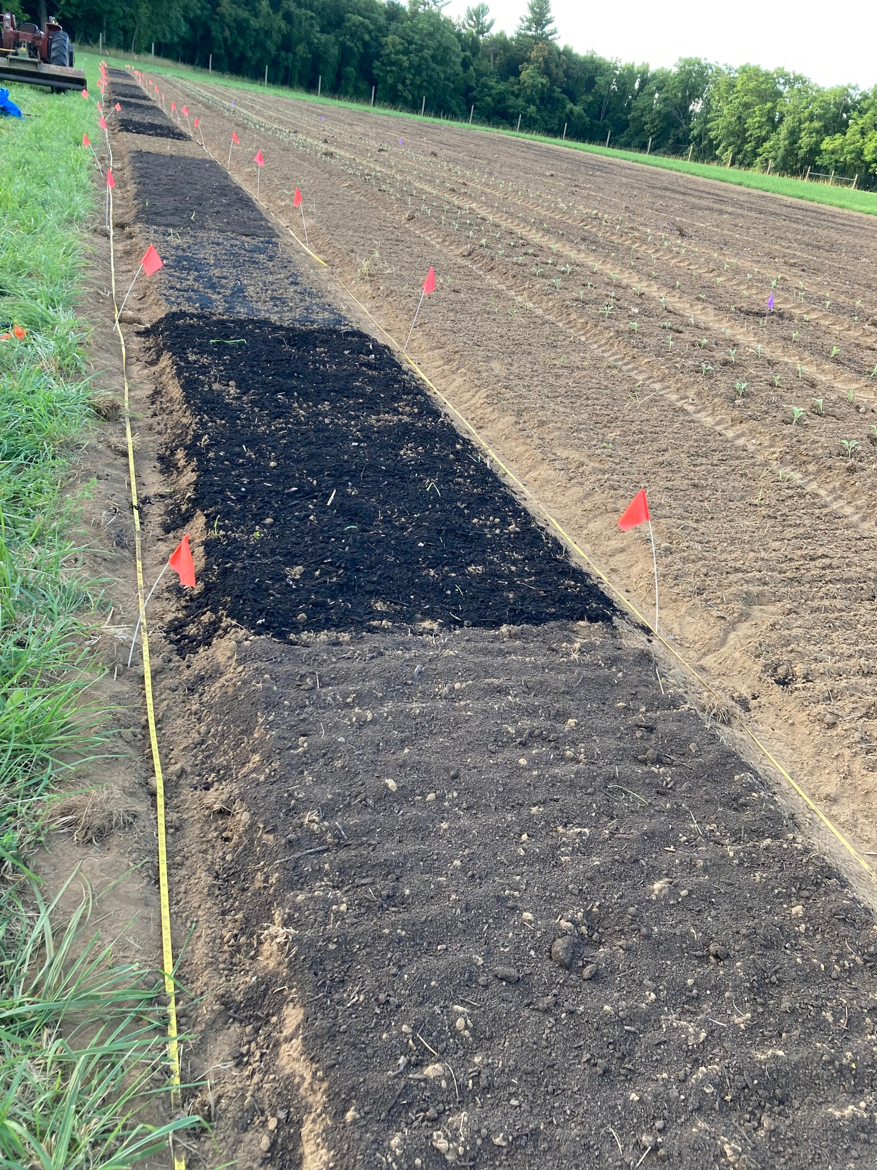
Biochar Rates
There are no standard rates. Depends on:
  Producer’s goals
  Soil health
  Cost and availability
  Etc.
Applying 4-10 cubic yards of wood chip-based biochar on degraded, acidic leaning soils is usually beneficial.
For mixing biochar with compost - 5-20% biochar (by volume) into compost is common in the scientific literature and among compost producers.

Slide 19
Biochar Case Study
Is there a good case study of biochar on farms

Slide 20
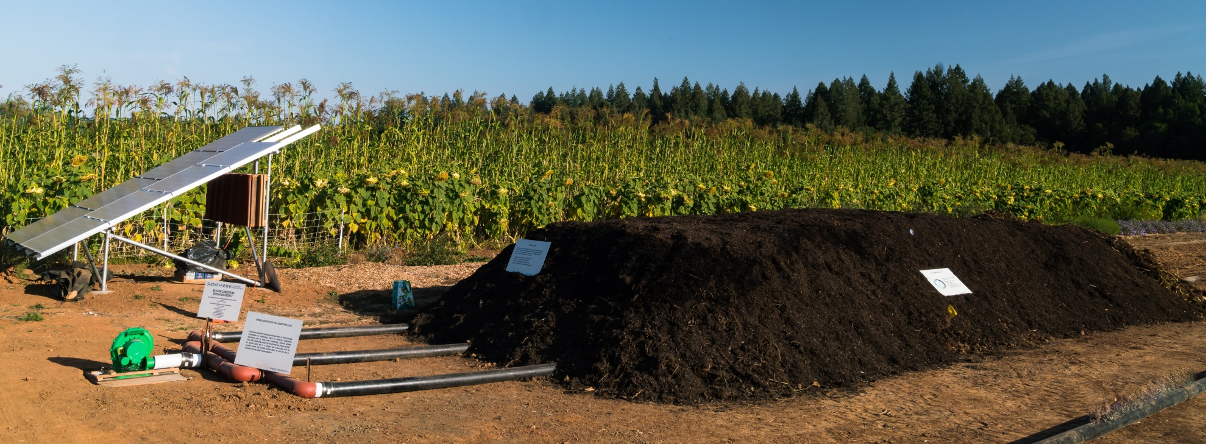
How is Compost application used on small-scale farms ?
Nutrient source
Amendment for carbon farming
Compost mulch systems for reducing tillage
Synergies with other soil health management practices
Others?
Notes:
Ask the participants to discuss this question and take a few responses.
Compost is often used for the combination of adding nutrients as well as adding a source of carbon to the soil, particularly in organic systems. Compost is an excellent source of most macro and micro nutrients.

Slide 21
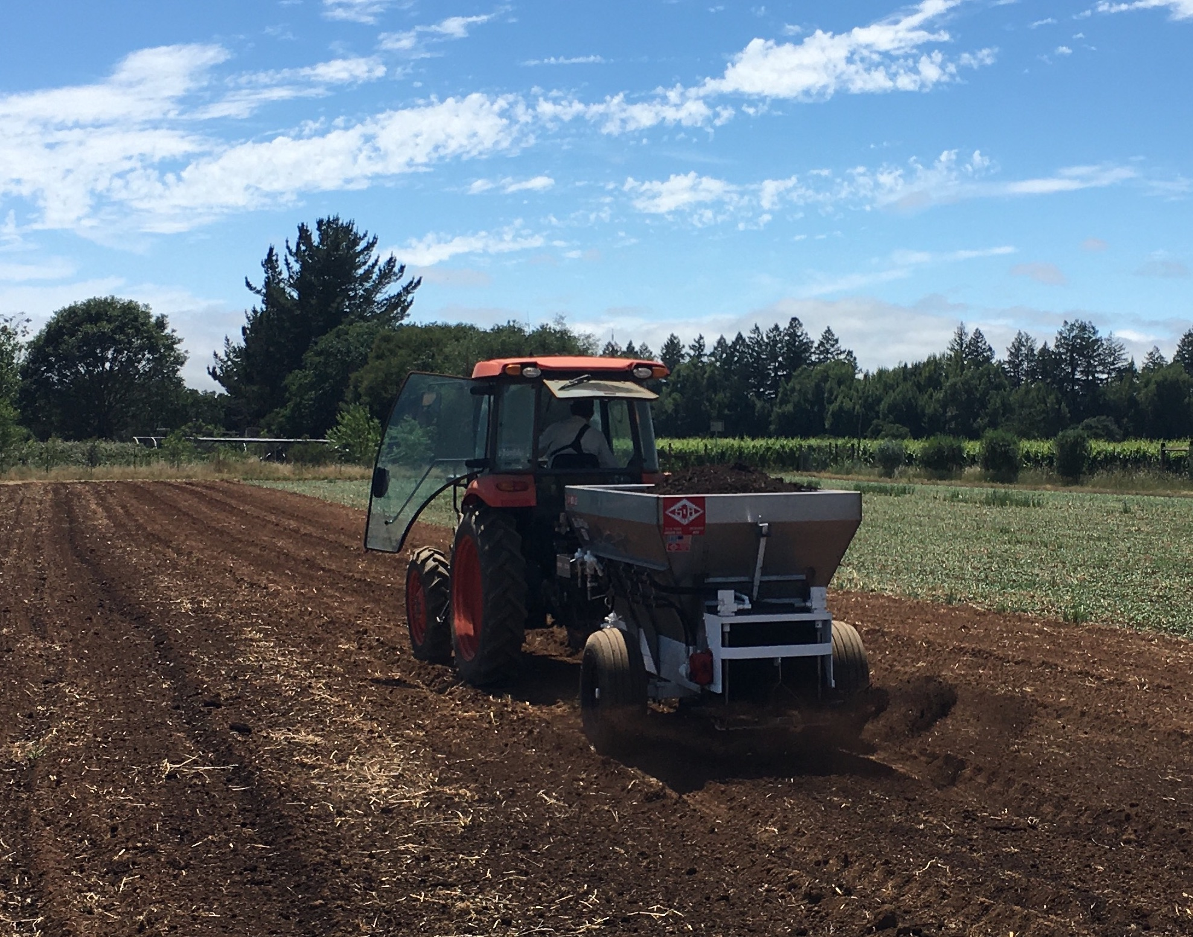
Compost Case Study
Long term study on maize – tomato cropping systems with tillage in Central Valley of CA (Tautges et al. 2019) observed:
  2 tons compost per acre per year + winter cover crop resulted in significant gains in soil C.
  Similar cropping system without compost lost soil C.
Notes:
Reference: https://onlinelibrary.wiley.com/doi/full/10.1111/gcb.14762

Slide 22
How can compost be used on urban sites with SH resource concerns?
Heavy initial applications on degraded soils.
Component of mixes for constructed raised beds.
Widely available and relatively inexpensive in urban areas

Slide 23
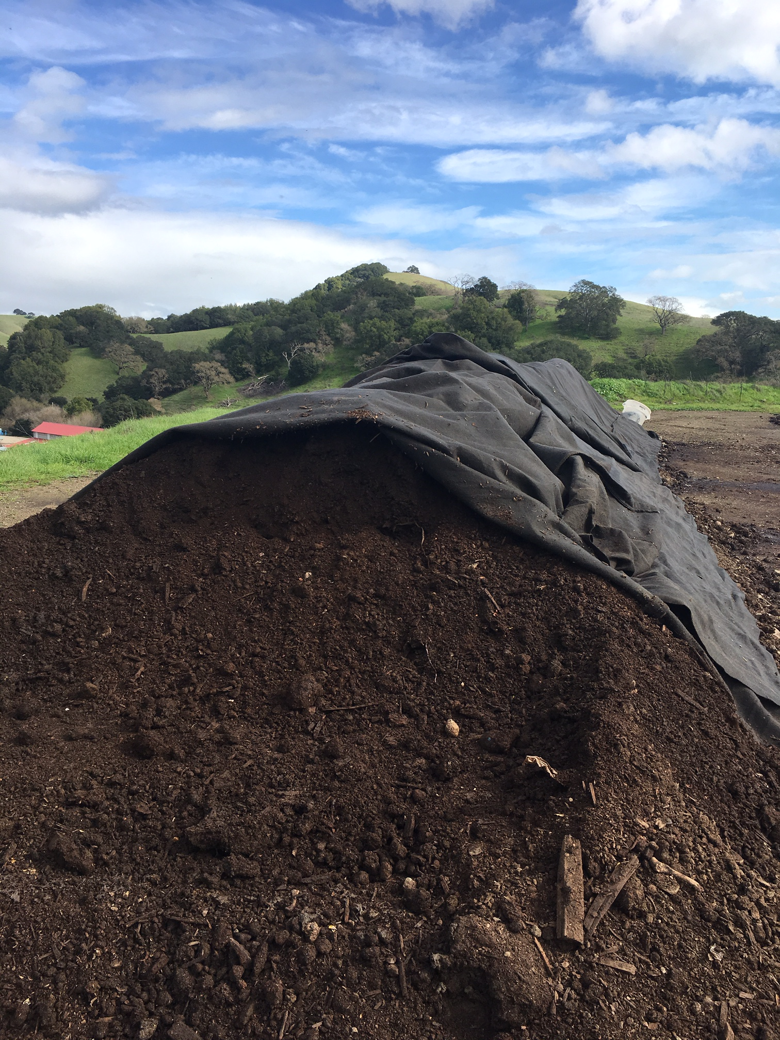
Management Considerations for Compost
Match C:N ratio of compost to producer goals.
  Lower C:N ratio for more nutrient availability
Monitor potential verapplication of nutrients – P in particular
  Nutrient management
Compost quality (potential contaminants)

Slide 24
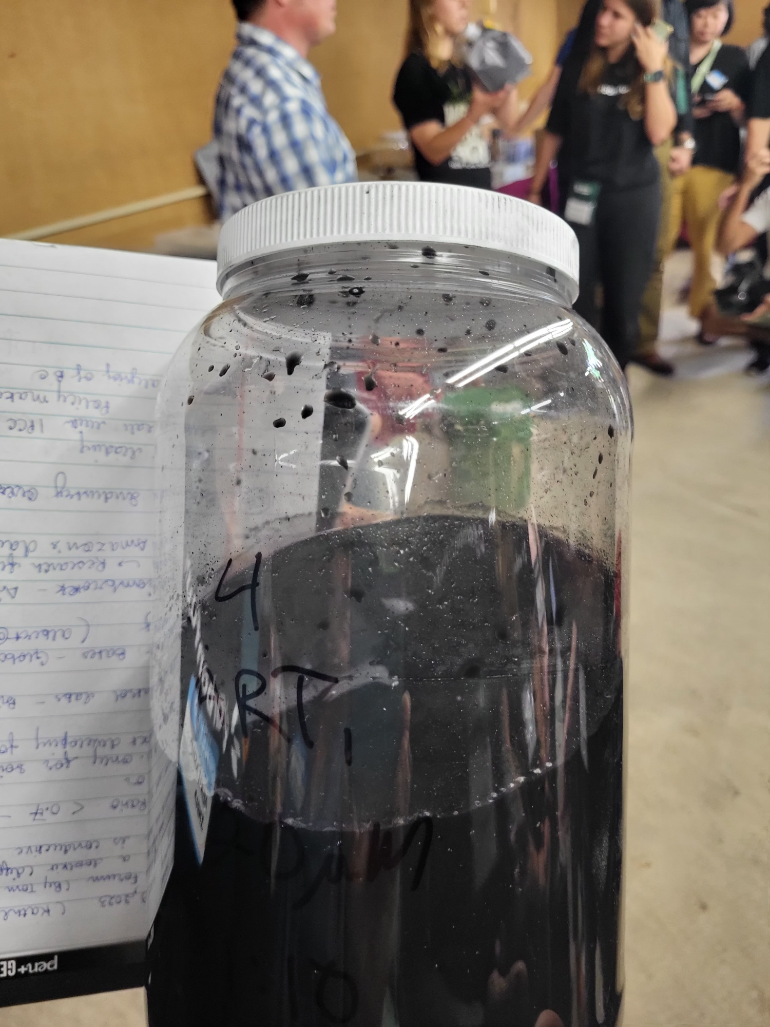
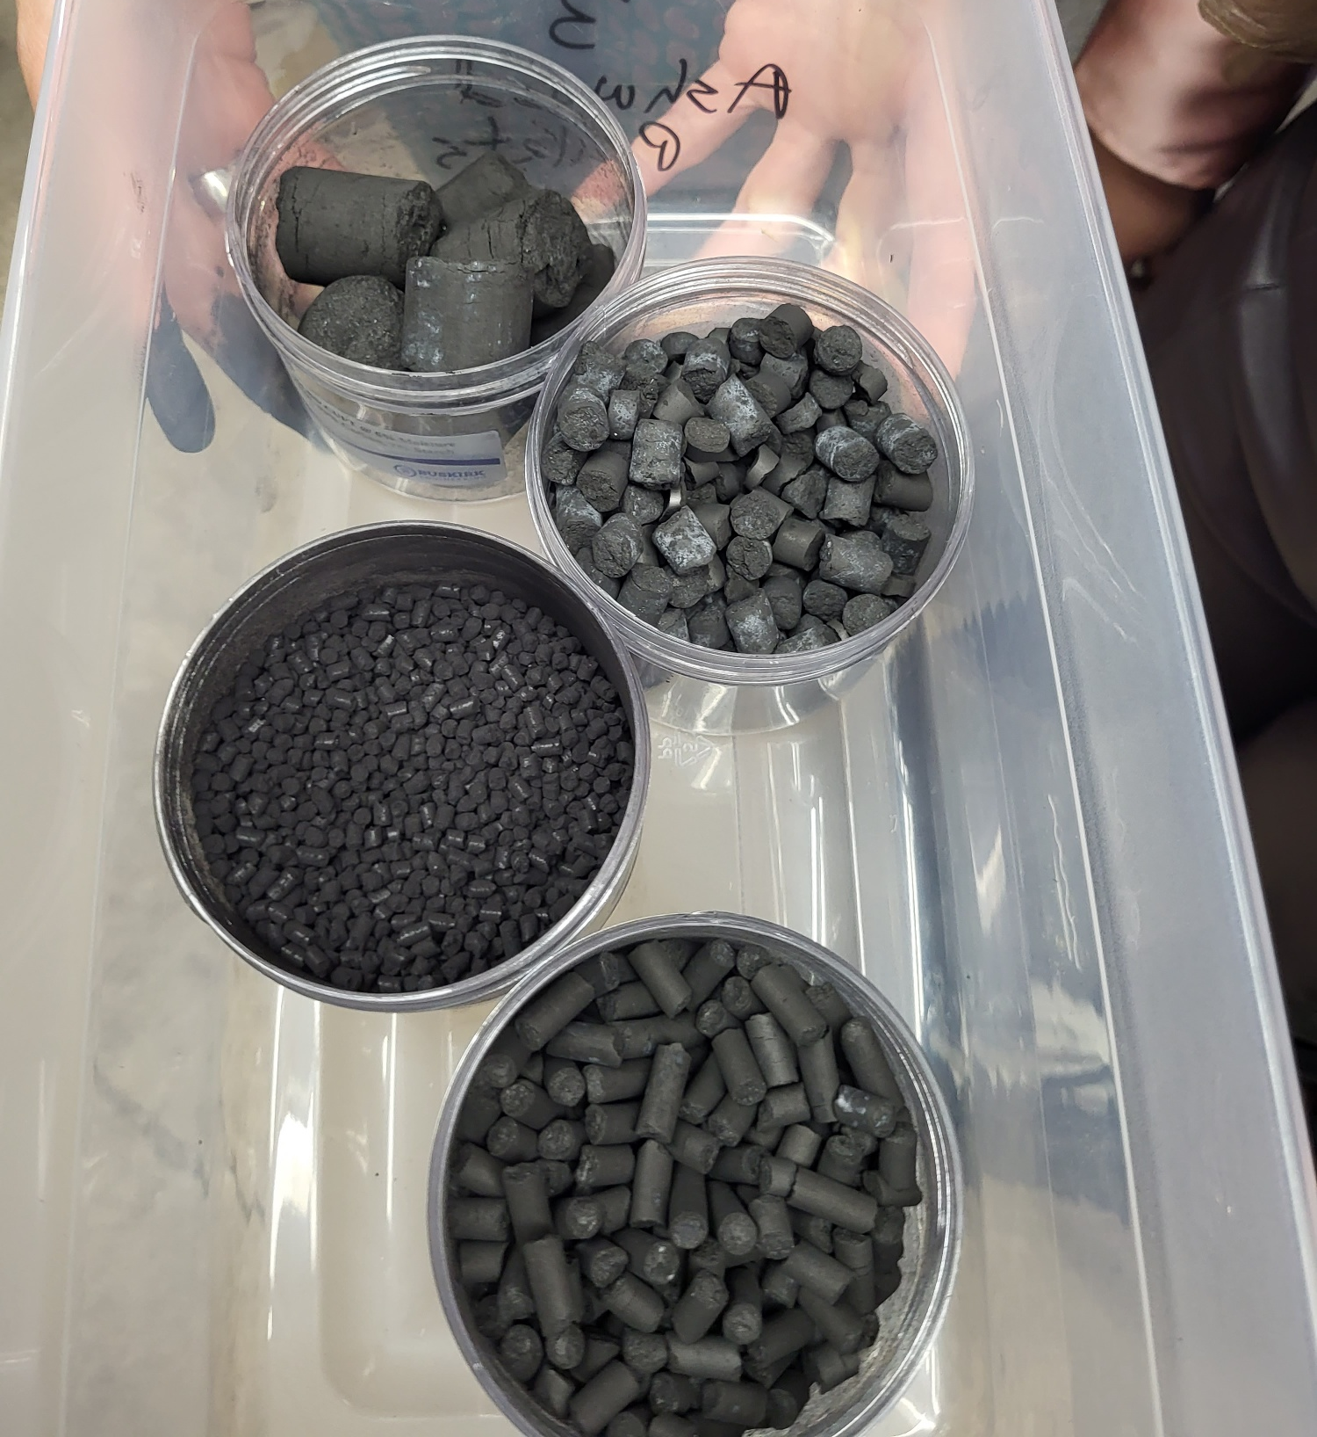
Ways to Incorporate Carbon Amendments
Surface spread
Tillage
Trenching it in (especially when planting perennials like trees, grapevines and berries)
When creating permanent beds.
No-till drill (i.e. biochar prills)
Fertigation (i.e. dissolve biochar in water and spread through irrigation)

Slide 25
CPS 336 – Soil Carbon Amendments
Practices Requirements

Slide 26
Soil Testing
A recent soil test (within the last 3 years) is required for the soil to which the soil carbon amendment is being applied.
CEMA 216 Soil Health Testing and/or CEMA 217 Soil and Source Testing for Nutrient Management can be contracted with 336.

Slide 27
Testing of Amendments
A detailed laboratory analysis is required for both Compost and Biochar materials used with the practice.
Testing of the carbon soil amendment is included in the payment scenario so should not be contracted separately.
When multiple C amendments are applied (eg, as a mixture such as 40% Biochar + 60% Compost), it is recommended that the local lab tests the compost constituents. Submit both the compost lab test results and the biochar spec sheet to the field office for review

Slide 28
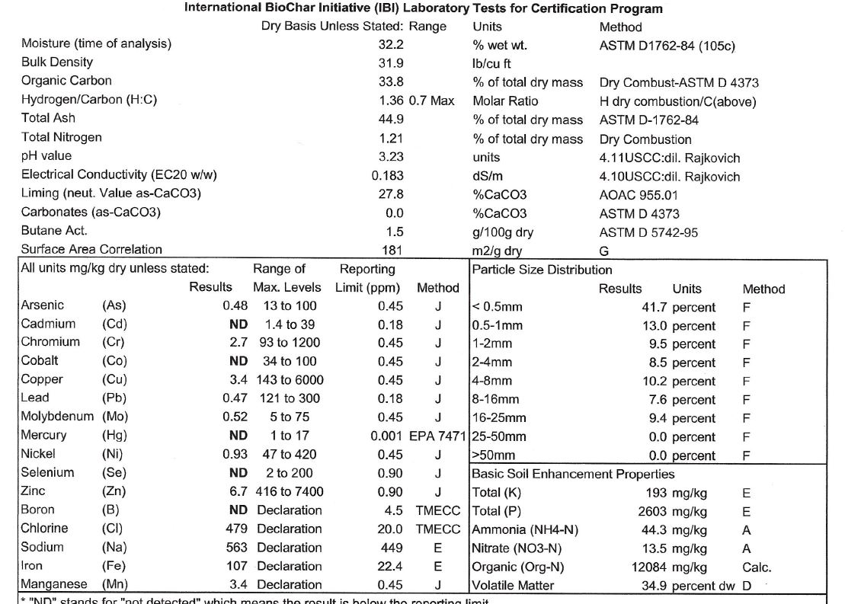
Biochar Testing

Slide 29
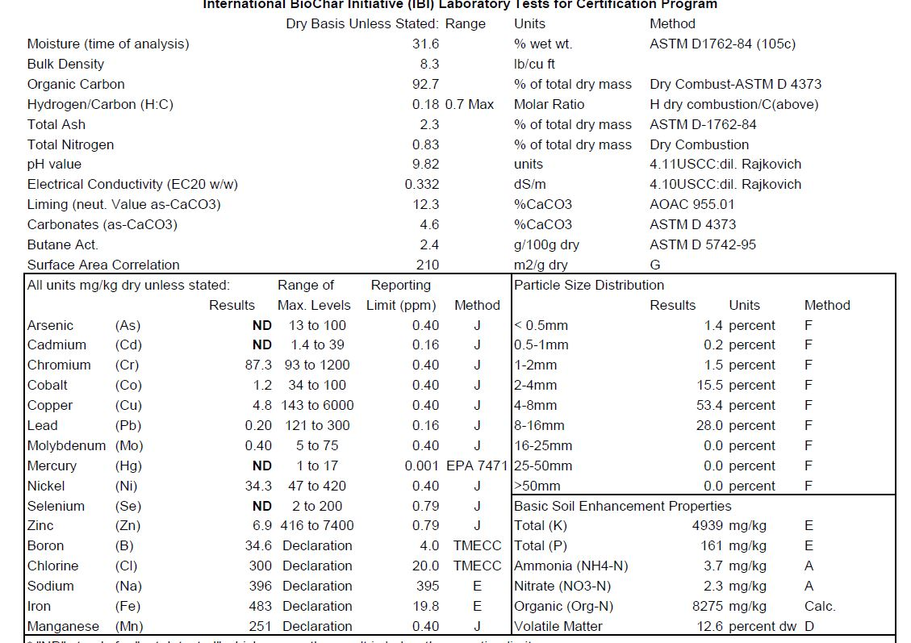
Hard Wood Biochar

Slide 30
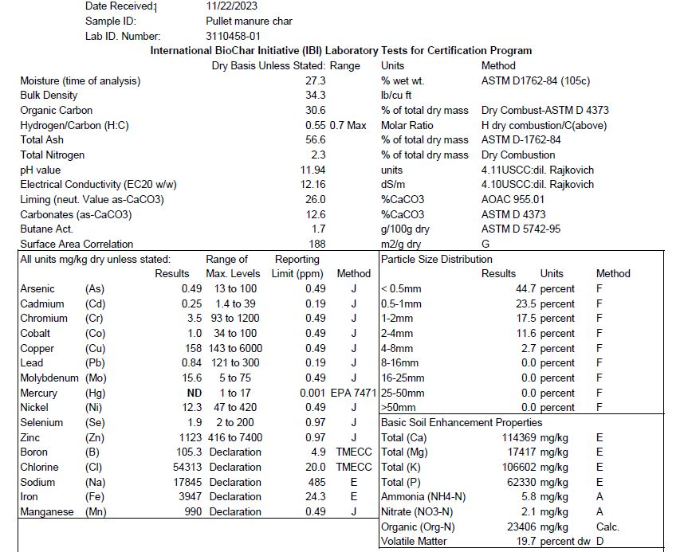
Manure Biochars
Significantly less organic carbon.
Higher in salts (as measured by EC).
Higher nutrient value (including P which can help bind lead).

Slide 31
Compost Test Results

Slide 32
Soil Carbon Amendments - Technical Resources
Pacific NW Biochar Atlas
Soil Carbon Amendment Calculator
Notes:
https://www.pnwbiochar.org/tools/tools_336/

Slide 33
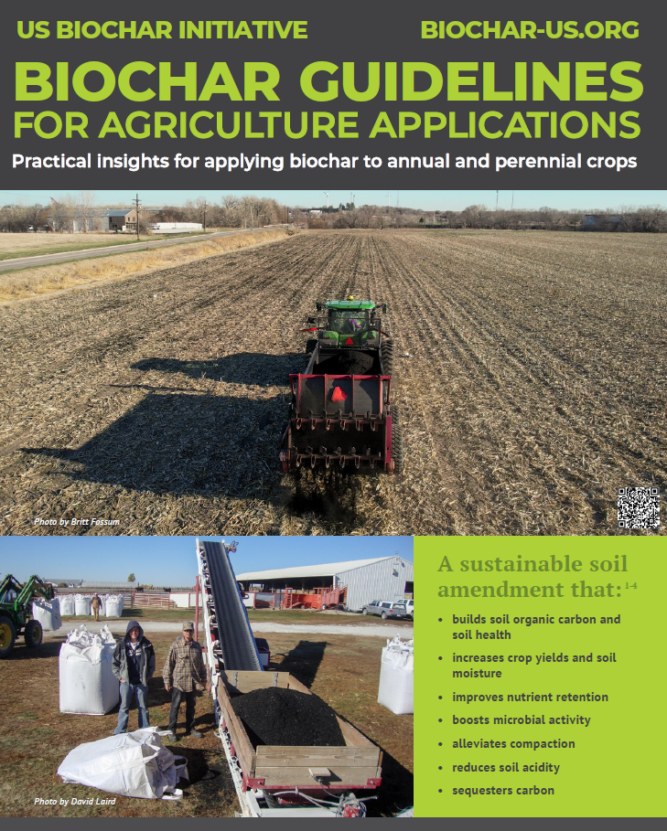
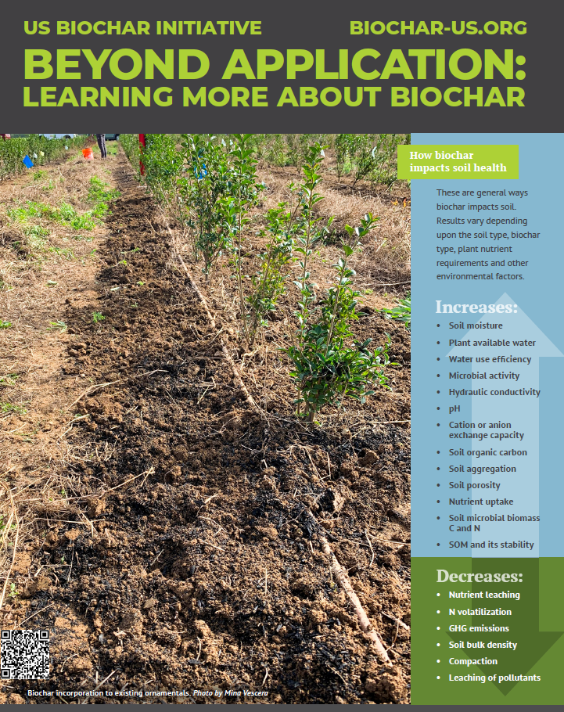
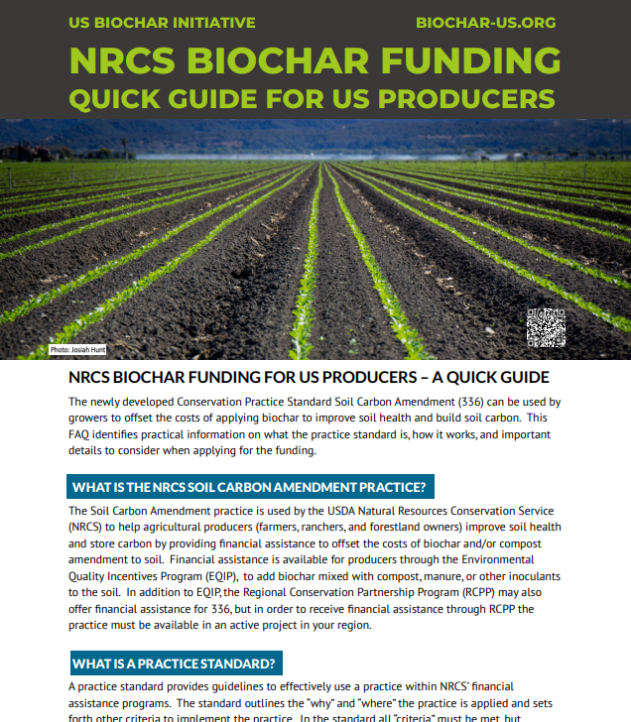
Some Useful Resources – U.S. Biochar Initiative Fact Sheets
*Not reviewed by NRCS.
Notes:
Biochar funding quick guide not reviewed by NRCS.

Slide 34
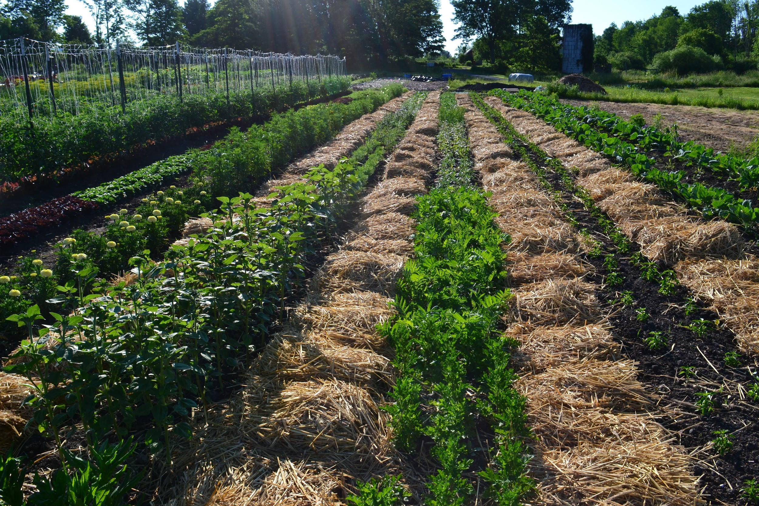

Slide 35
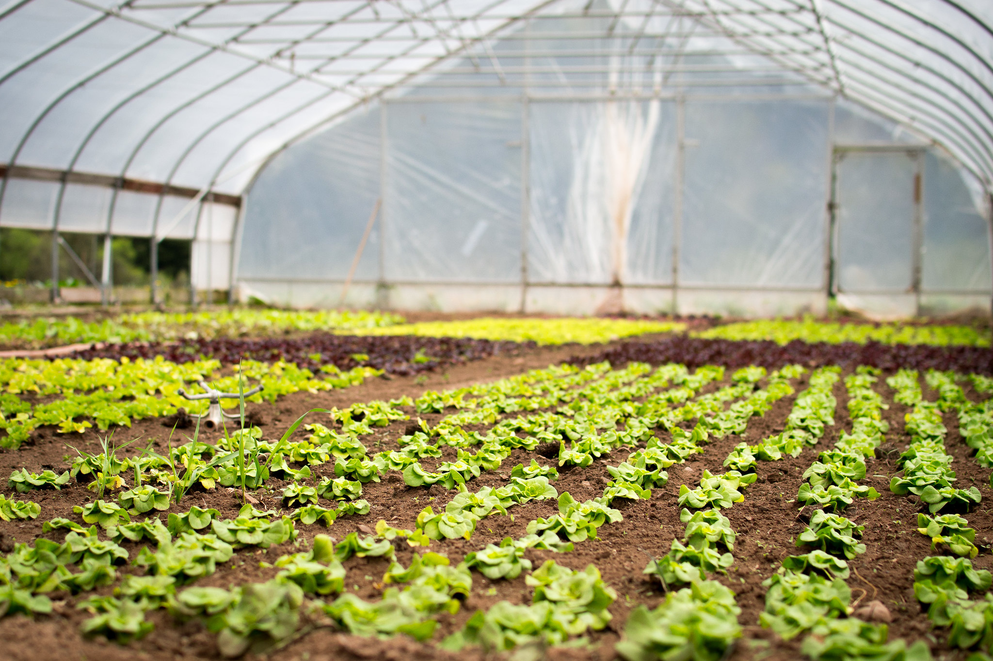

Slide 36
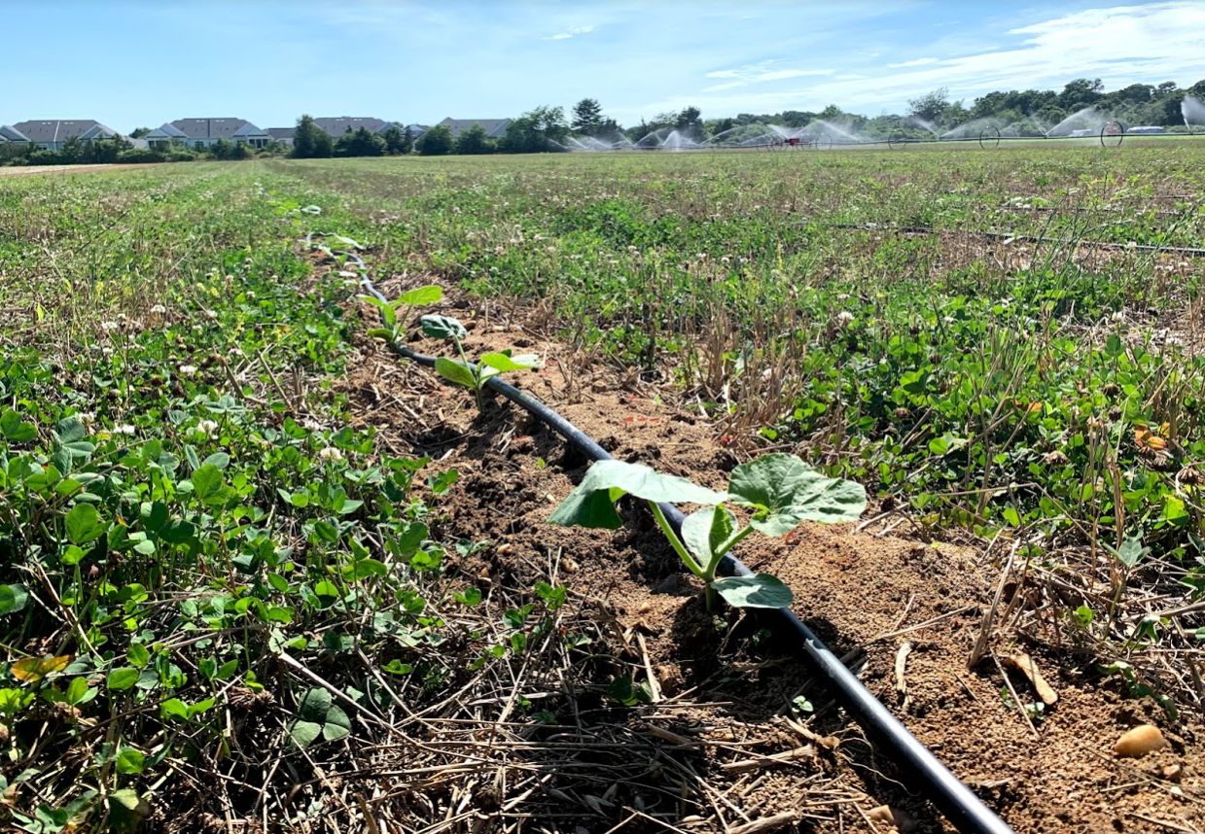

Slide 37
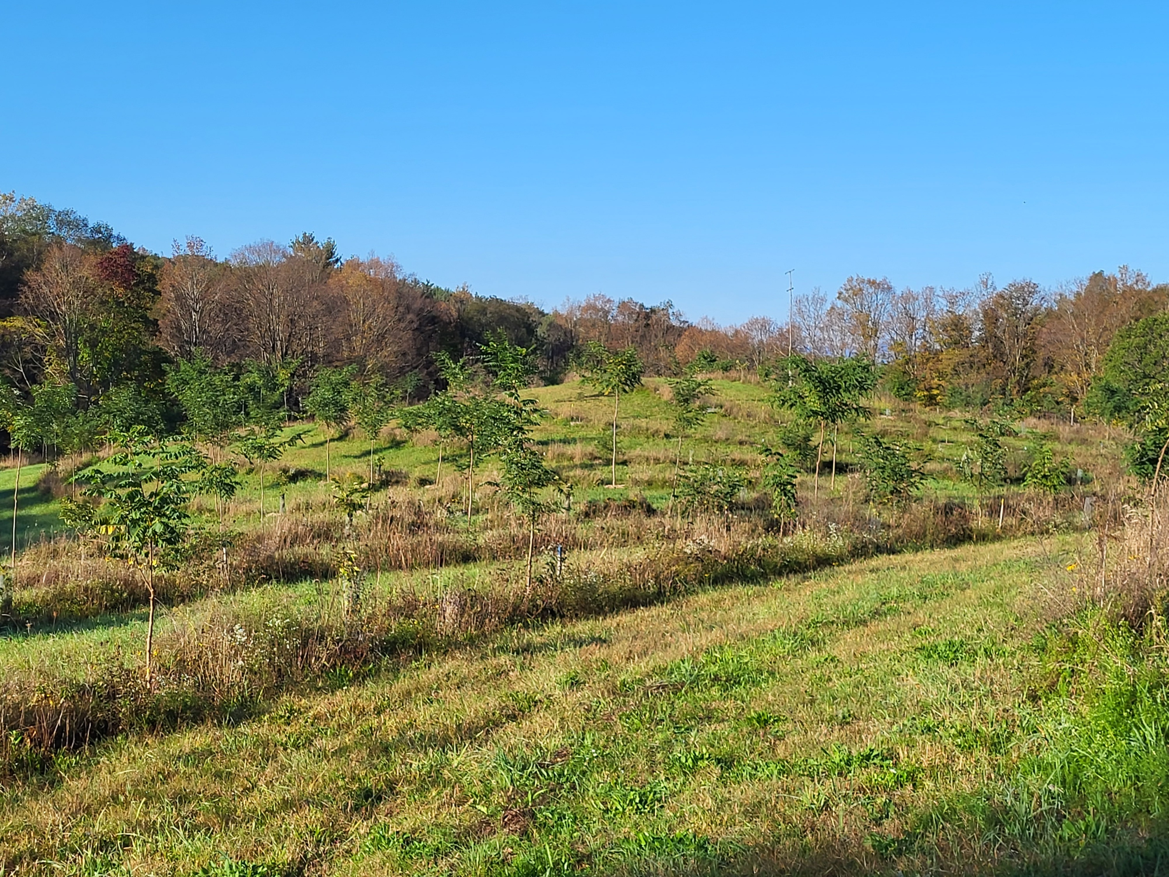
Common Applications:

Slide 38
Review and Questions
Soil carbon is crucial for healthy soils. It makes soils more resilient and feeds soil biota, increases water and nutrient holding capacity, nutrient availability, reduces compaction, and improves plant health.
Soil carbon amendments such as compost and biochar can have benefits in urban soils such as reducing the mobilization of lead and salts and improving plant available moisture.

Slide 39

This information is provided as a public service and constitutes no endorsement by the United States Department of Agriculture or the Natural Resources Conservation Service of any service, supply, or equipment listed.
While an effort has been made to provide a complete and accurate listing of services, supplies, and equipment, omissions or other errors may occur and, therefore, other available sources of information should be consulted
The USDA is an equal opportunity provider and employer.
Meeh, NRCS

